Slide 1
PyLLUTION
I.T. SOLUTIONS FOR AIR QUALITY DETECTION

Slide 2
Problem
«Create algorithms that select or weight the best data from several sources for a specific time and location, and display that information»
By NASA

Slide 3
Background
Air pollution is associated with almost 5 million annual deaths worldwide as well as harm to countless others through negative health impacts, from asthma and diabetes to cardiovascular disease and cancer.
Focus on three cities:
Addis Ababa, Ethiopia;
Delhi, India;
Los Angeles, United States.

Slide 4
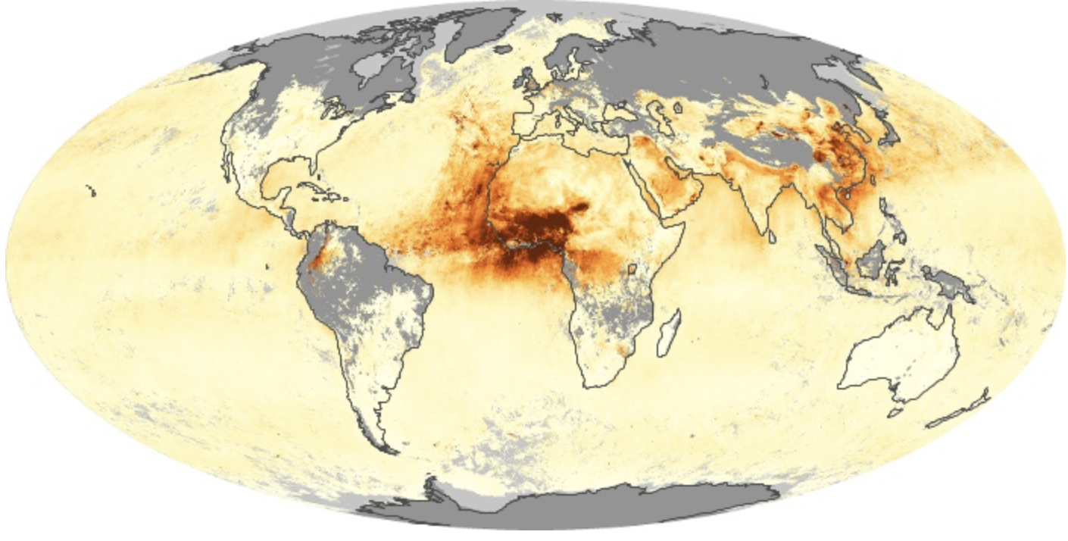
Data - Aerosol Optical Depth (AOD)
Satellite-derived Aerosol Optical Depth (AOD) produced from the NASA MODIS instruments;

Slide 5
Data - Meteorological Data
365 meteorological data files corresponding to each day of 2018.
Each file are 24 hourly measurements for each of the 22 station locations.
These data are used to improve the accuracy of the relationship between the satellite-derived AOD quantity.

Slide 6
Data - Ground Monitor Data
OpenAQ has collected over 170 million air quality measurements, and this number grows every 10 minutes.
OpenAQ provides their data untouched, so that users can decide for themselves how to validate and analyze the raw data.
Data data is messy.

Slide 7



Playground

Slide 8
Pyllution Approach
Make messy and un-user friendly data easy to use
Mixing information from several resources in order to have a single index to determine the pollution value
Create a GUI easy to use and interactive, in which users could be download data and using it

Slide 9
Merge different dataset
Consistent on data type (str, int, …)
Create a single low weight dataset coming from different resources
Build functions to handle this huge amount of data

Slide 10
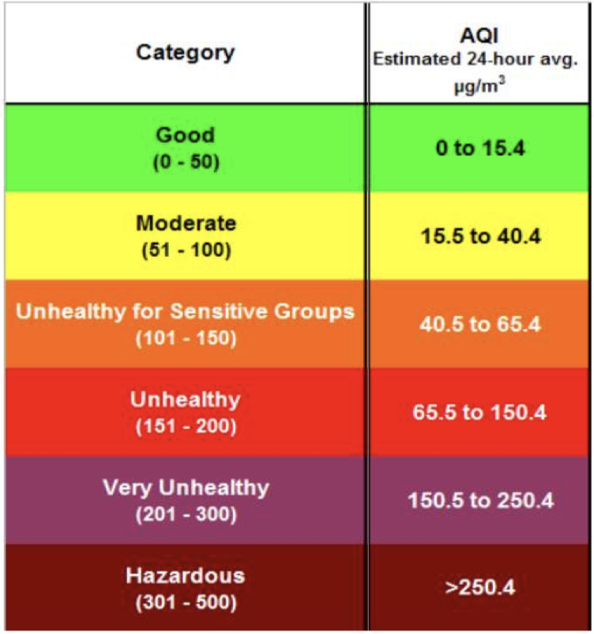
Determine a single index
Converting AOD to PM2.5: A Statistical Approach, NASA ARSET Workshop, 2016

Slide 11
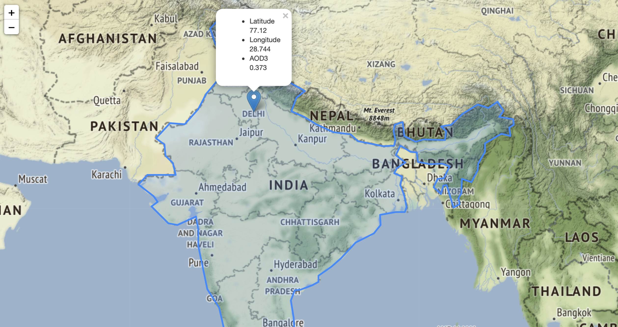
User experience

Slide 12
For future and beyond
Better GUI
Implement prediction Day by Day
Create an API with which users can download files containing all data

